Slide 1
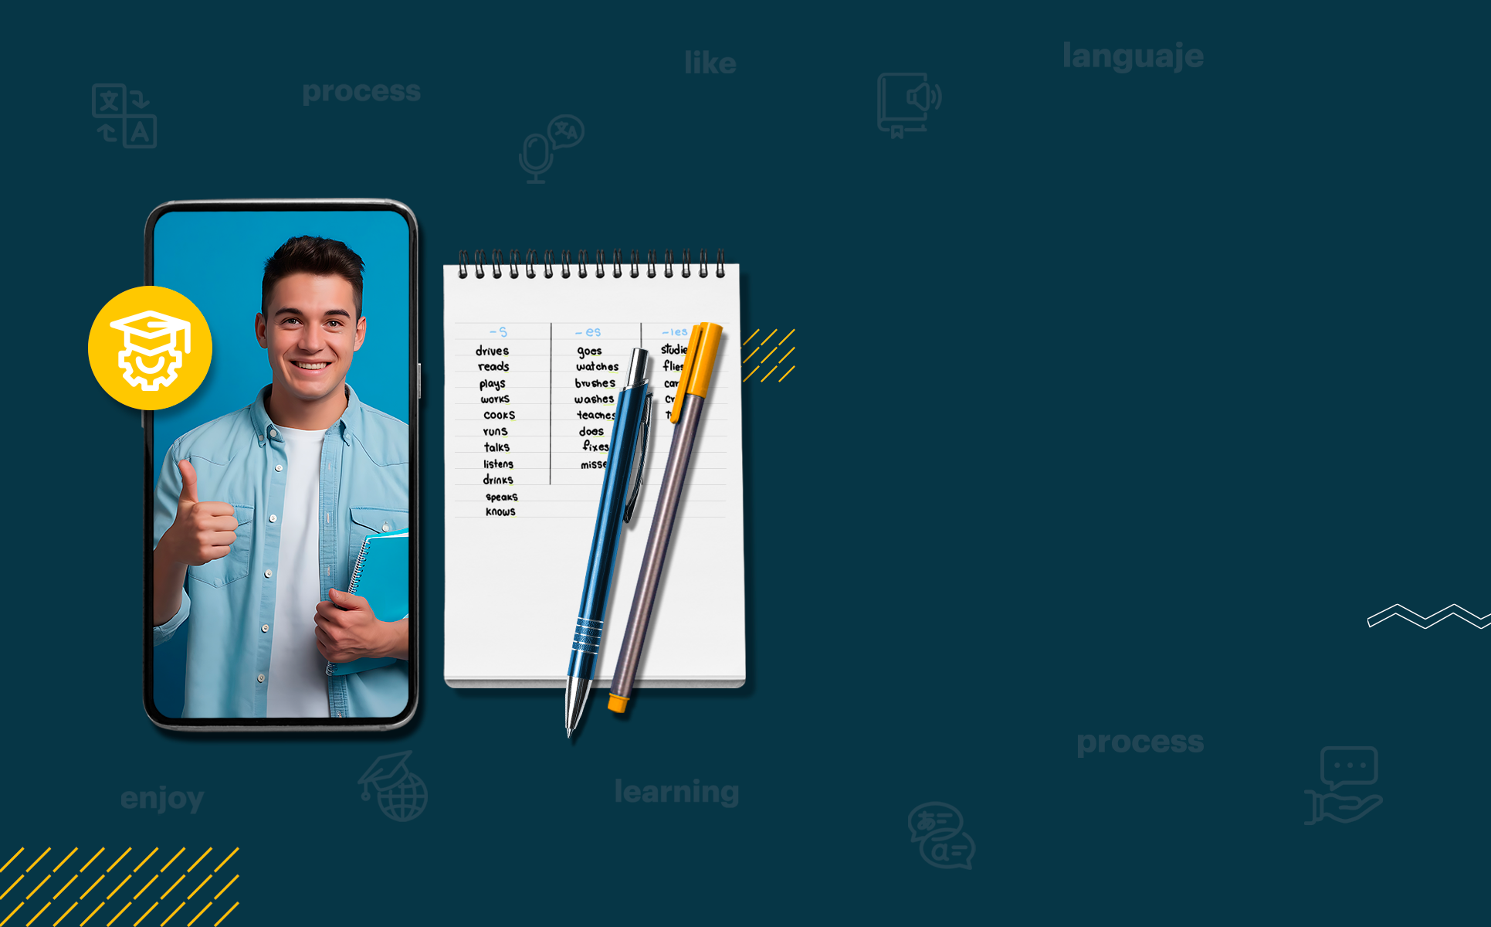

ENGLISH LEVEL B1 - II
Lesson 05
MAKING AN APPOINTMENT ON THE PHONE

Slide 2

01
Making an appointment on the phone
ENGLISH LEVEL B1 - II

Slide 3
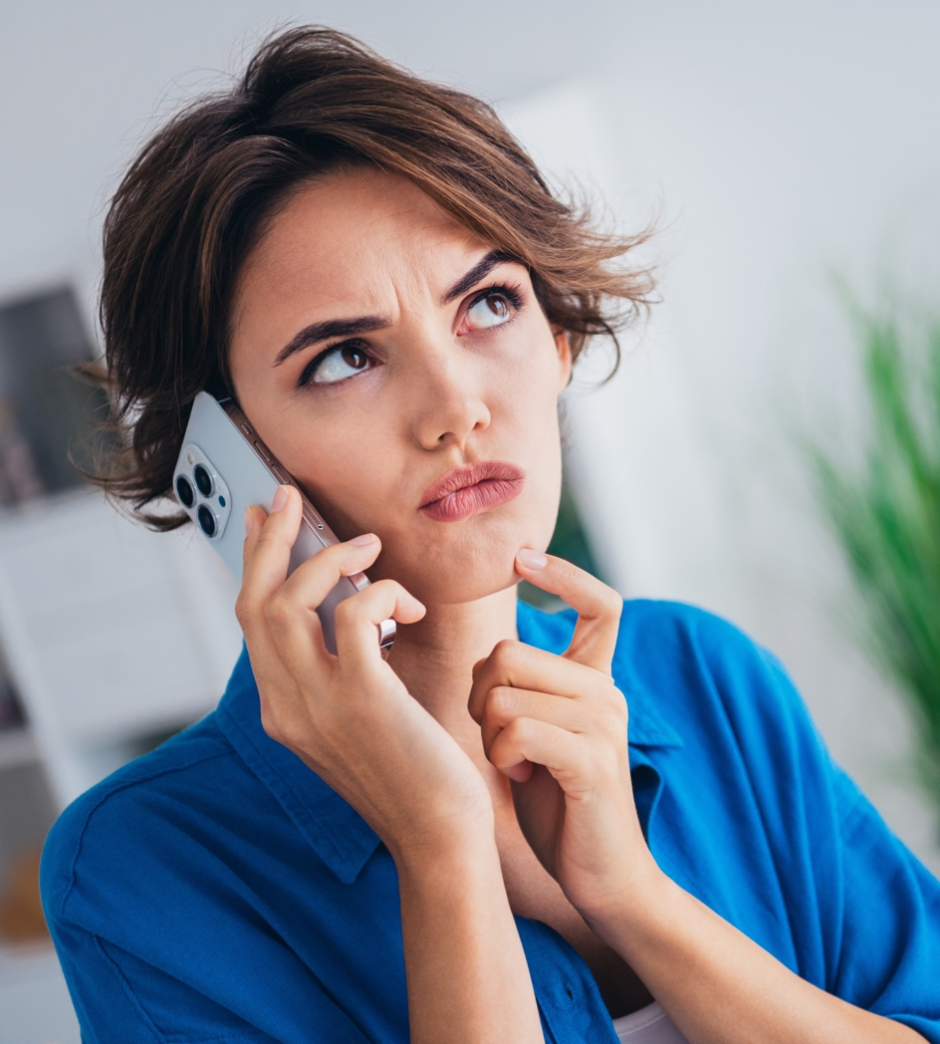
MAKING AN APPOINTMENT ON THE PHONE
SPEAKING ON THE PHONE CONTEXT
Listen to the conversation Making an Appointment on the Phone and answer the questions below:
1
Why does Mrs. Anderson call the hair salon?
2
Why is it difficult to get an early appointment at the hair salon?
3
How does Mrs. Anderson finally get an earlier appointment?
4
What does Mrs. Anderson request for her daughter?
INSERTAR DIÁLOGO ALTISSIA

Slide 4
MAKING AN APPOINTMENT ON THE PHONE
Vocabulary:
Activity:
"I’d like to book an appointment for..."
"Is there any availability for..."
"What time slots do you have available?"
"I prefer (morning/afternoon/evening)."
"Can I reschedule my appointment?"
"Unfortunately, we are fully booked."
"We have an opening at..."
"Is it possible to get an earlier appointment?"
Put the words in the correct order to form proper appointment-related questions:
book / appointment / I’d / an / like / to
availability / this / there / week / any / is / for?
get / an / earlier / to / possible / is / it / appointment?
stylist / a / request / can / I / specific?
time / slots / do / what / available / you / have?

Slide 5

MAKING AN APPOINTMENT ON THE PHONE
ROLE-PLAY EXERCISE:
Work in pairs. One student will be the customer, and the other will be the receptionist.
The customer must call to book an appointment for a service (haircut, dentist, doctor, restaurant, etc.).
The receptionist will check availability and respond accordingly.
Switch roles and repeat and then share the dialogue to the class.

Slide 6

MAKING AN APPOINTMENT ON THE PHONE
CLASS DISCUSSION: REFLECT AND APPLY
Can you name three phrases to ask for an appointment?
How would you ask if there are available time slots for a haircut?
If the receptionist says, "Unfortunately, we are fully booked," what could you say next?
How can you politely ask to reschedule an appointment?
What would you say if you want a specific stylist?

